Slide 1

APP SUBSCRIPTION ANALYSIS
Made by:
Luv Dhamija
Sankeerth K.R.
Ankush Sharma
Mentor:
Dr. Ramana Deverkonda
Co-Mentor:
Dr. A.V. Krishna Prasad

Slide 2
PROBLEM STATEMENT
We have an application data and are supposed to predict the customer who will take a premium version app subscription or not.
It has two versions free and premium. The free version app contains basic features and customer wants to use the premium feature then they have to pay some amount to unlock it
The data contain the customer’s behaviour and our job to find the insights from it.
The problem here is to predict new customer who is interested to buy the product or not. If the customers will buy a product anyway so no need to give an offer to that customer and reduce loss of business.

Slide 3

MOTIVATIONS AND BENEFITS FROM PROJECT
Interesting project:-Dataset has numerical, categorical as well as date-time variables which made dataset challenging and interesting.
Critical thinking:- In this project we were able to think like a professional developing a solution from a situation
In-depth Exposure of Machine learning
Improve Ourselves in the field of data science and story telling from the data

Slide 4
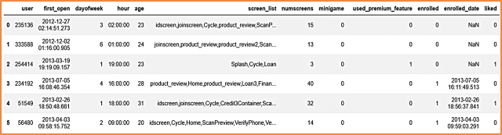
DATASET
Data – Statistics
Number of columns: 12
Number of entries: 50000
Missing values: 18926
Missing values %: 37.582
Duplicate rows: 15
Duplicate rows %: 0.03
Variable types: (int64 - 8), (object – 4)

Slide 5
Dataset – Attributes
User – User ID.
First-Open – When the app was opened first.
Day-Of-Week – On which day the app was opened.
Hour – At what time app was opened.
Screen-List – List of screens opened by users.
Num-Screens – Total number of screens.
Mini-Game – If the app has mini-games.
Used-Premium-Feature – Whether user has used premium feature or not.
Liked – Whether user liked the app or not.
Enrolled – Whether user enrolled for subscription or not.
Enrolment-Date – When did the user enrol.

Slide 6
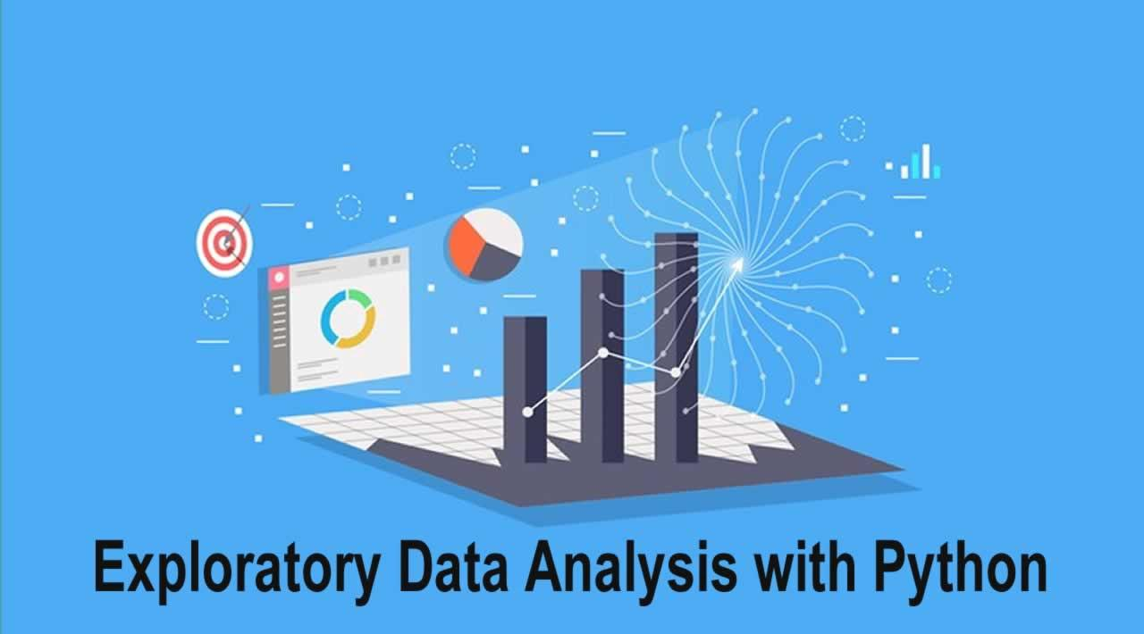
EXPLORATORY DATA ANALYSIS
Exploratory data analysis (EDA) is an approach to analyzing data sets to summarize their main characteristics, often with visual methods.
Exploratory Data Analysis (EDA) is used to answer questions, test business assumptions, generate hypotheses for further analysis.
Summarizing your dataset through descriptive statistics.
The following graphs explains the EDA performed on the datasets and insights derived from it.

Slide 7
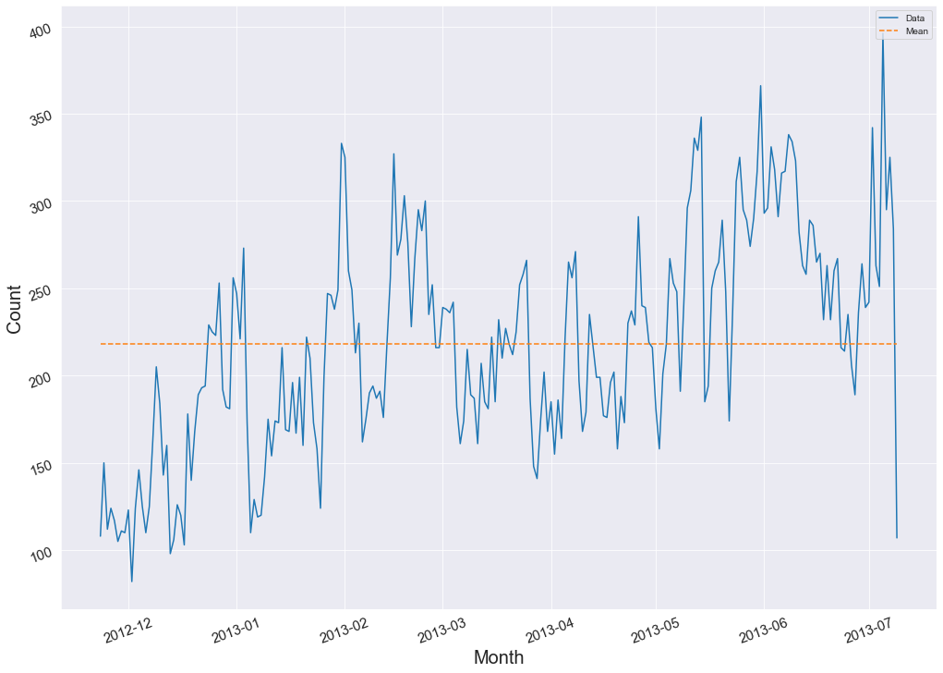
User first opened the app across month

Slide 8
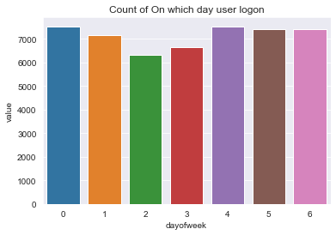
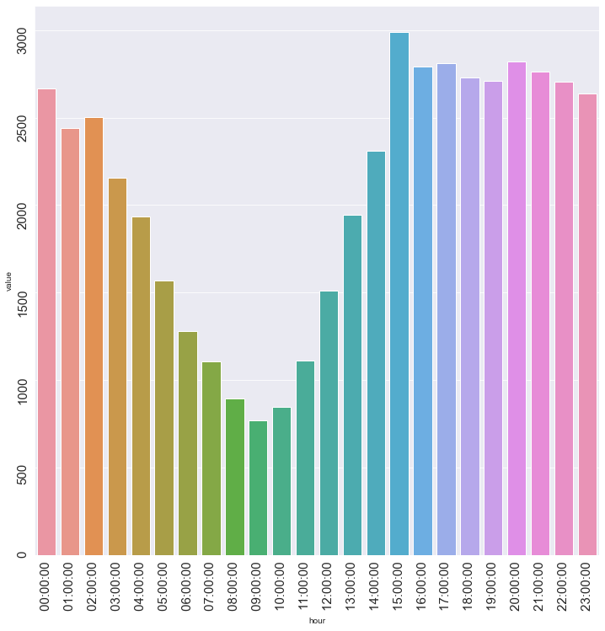
Number of users logged in on a particular day
Number of users logged in on a particular hour

Slide 9
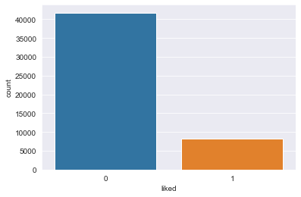
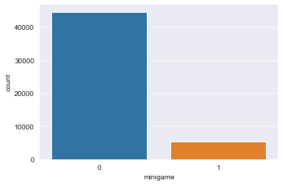
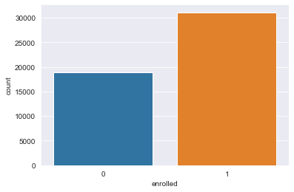
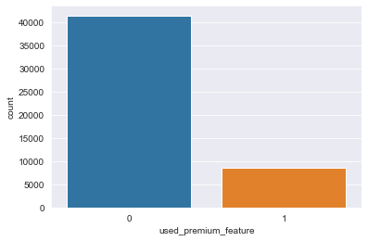
Count plot of different columns

Slide 10
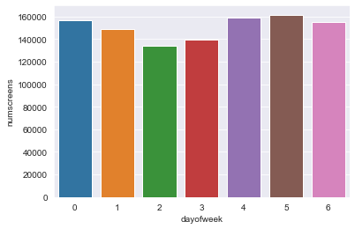
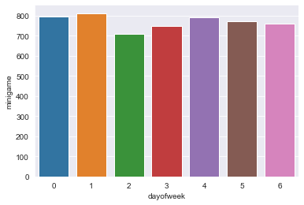
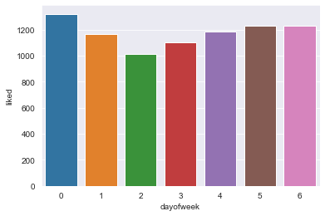
Bar graph of different column w. r. t . Day-of-week

Slide 11
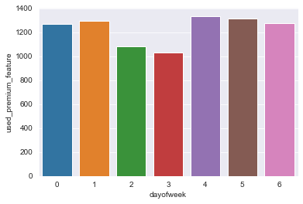
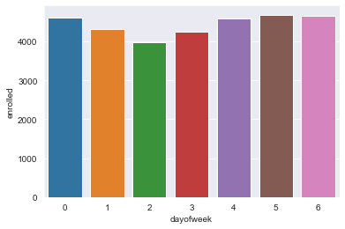

Slide 12
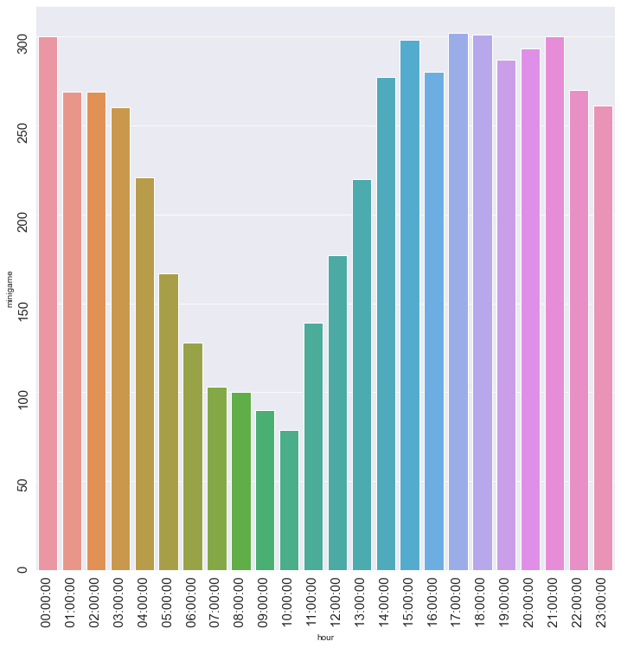
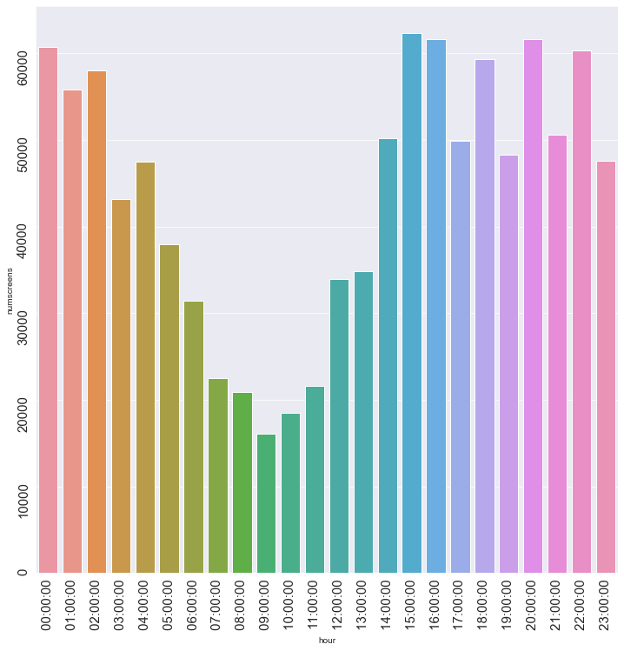
Bar graph of different columns w. r. t. hours
Mini-game
Num-screen

Slide 13
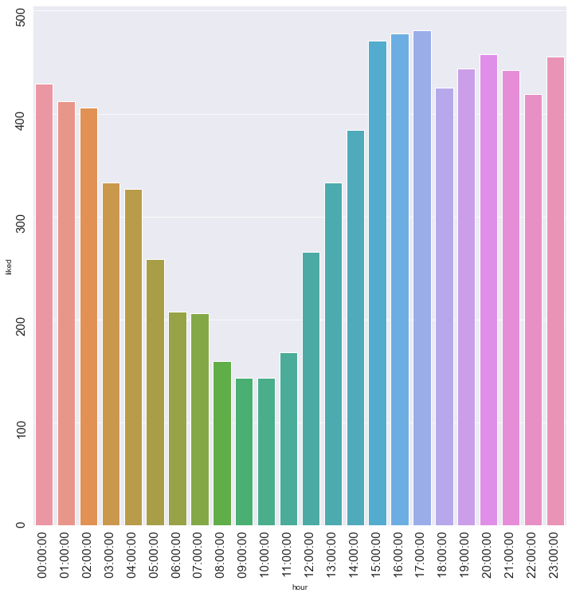
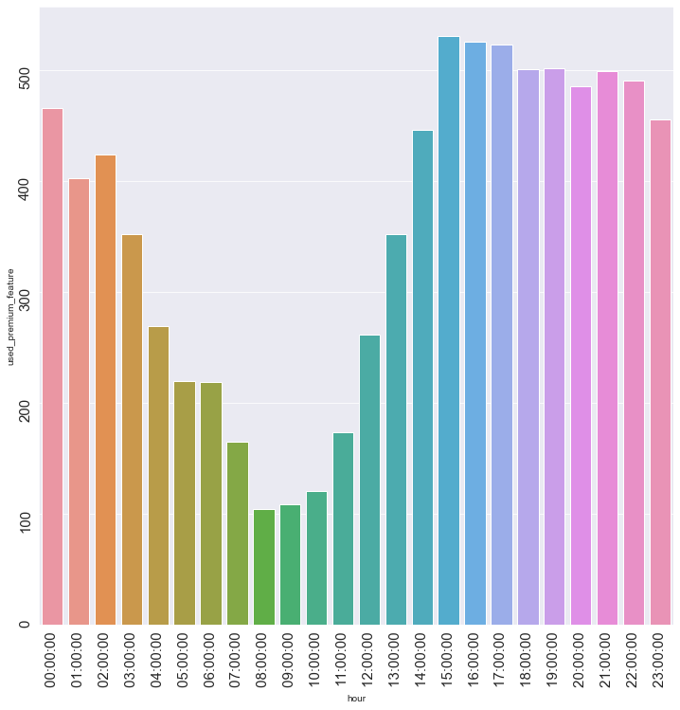
liked
Used-premium-feature

Slide 14
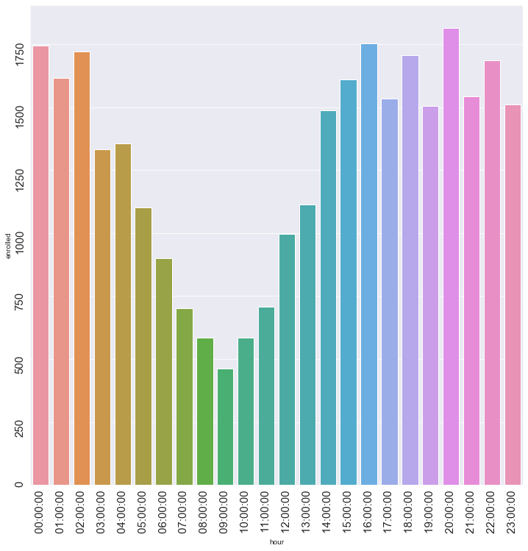
Enrolled
From the above graphs, we can say that users were more active in afternoon and evening as compare to the morning.

Slide 15
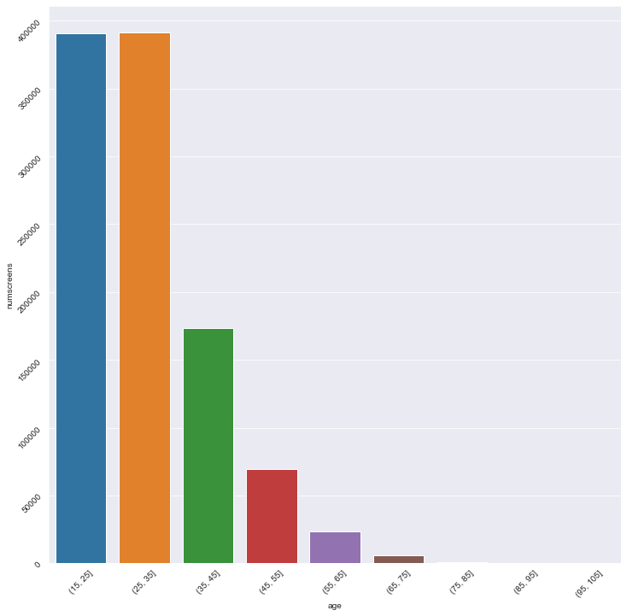
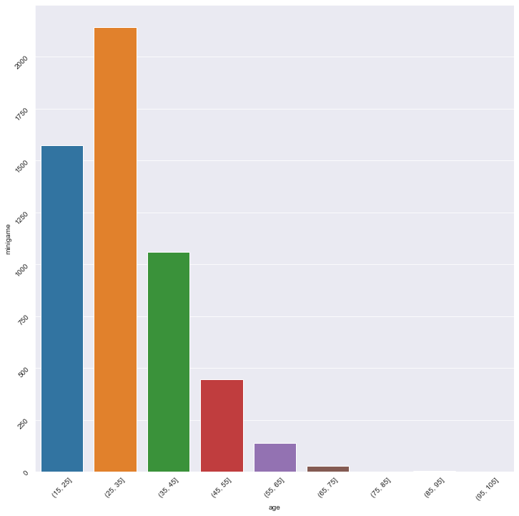
Bar graph of different columns w. r. t. age
Num-screen
Mini-game

Slide 16
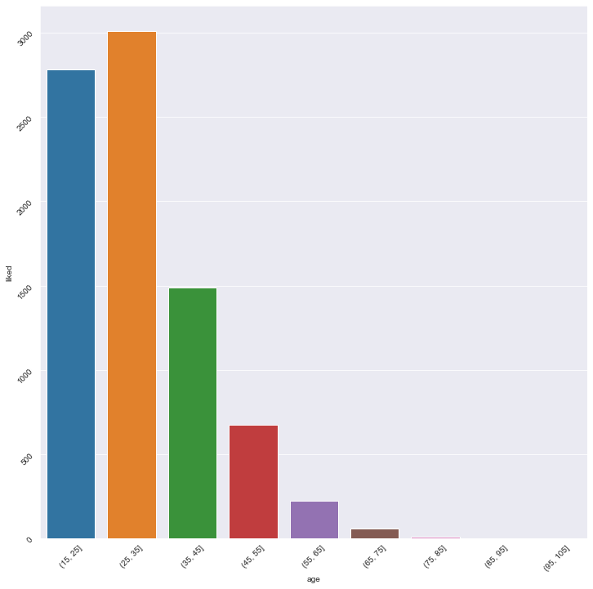
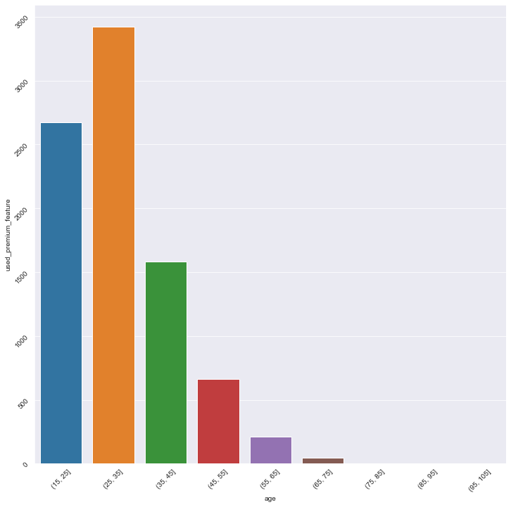
Liked
Used-premium-feature

Slide 17
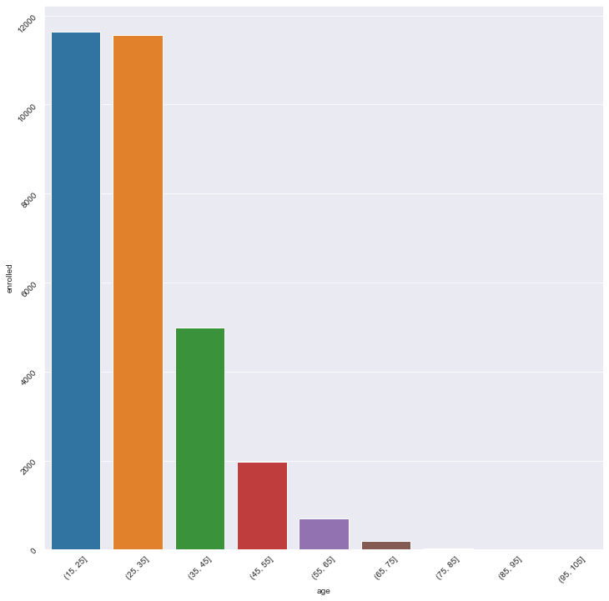
Enrolled
From above age graphs, we can say that most active users are between the ages of 25 – 35.

Slide 18

MODEL BUILDING
Feature selection
Feature Engineering
Data pre-processing
Model selection
Implementation

Slide 19
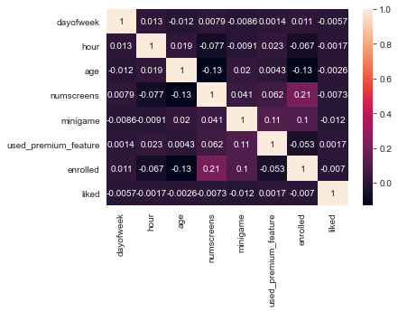
FEATURE SELECTION
Correlation Matrix
Enrolled column is mostly dependent on number of screens and list of screens.

Slide 20
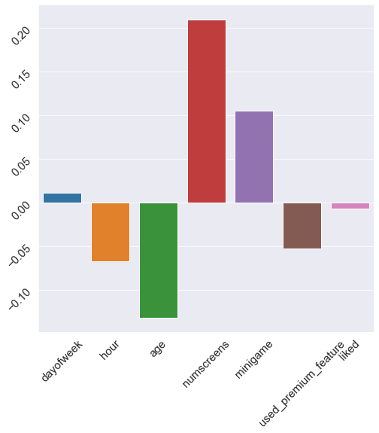
Correlation with the response variable
This means

Slide 21
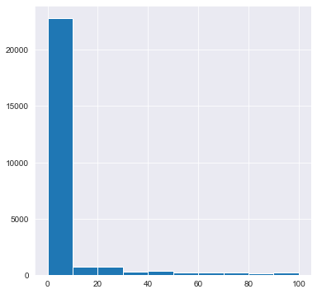
FEATURE ENGINEERING
Feature engineering is the process of using domain knowledge to extract features from raw data via data mining techniques. These features can be used to improve the performance of machine learning algorithms. Feature engineering can be considered as applied machine learning itself.

Slide 22
FEATURE ENGINEERING METHODS
Parsing: parsing is used to convert object into time-delta variable type, which is used to deal with data time columns and for removing outliners from the dataset.
Transaction Encoding: It is an encoding technique to deal with screen list column in the dataset. It maps screens to fields(different columns).
Slicing was used in hour column to convert it into integer type.
Combined columns with same names. For ex: ‘loan’, ‘loan1’, ‘loan2’ were combined and named as ‘loan count’.

Slide 23
Difference column was generated by subtracting first open with enrolled date. This column tells us about time of response of a user to enrol to premium feature. It is one of the most important column that helps us to deal with outliners
Converting all entries of enrolled to 0 if their correspondence difference is greater than 40. Hence deal with outliners.
Dropped unimportant columns: first open, enrolled date, difference(after dealing with outliners), users.

Slide 24

DATA PREPROCESSING
Pre-processing refers to the transformations applied to our data before feeding it to the algorithm.
Data Pre-processing is a technique that is used to convert the raw data into a clean data set. In other words, whenever the data is gathered from different sources it is collected in raw format which is not feasible for the analysis.

Slide 25
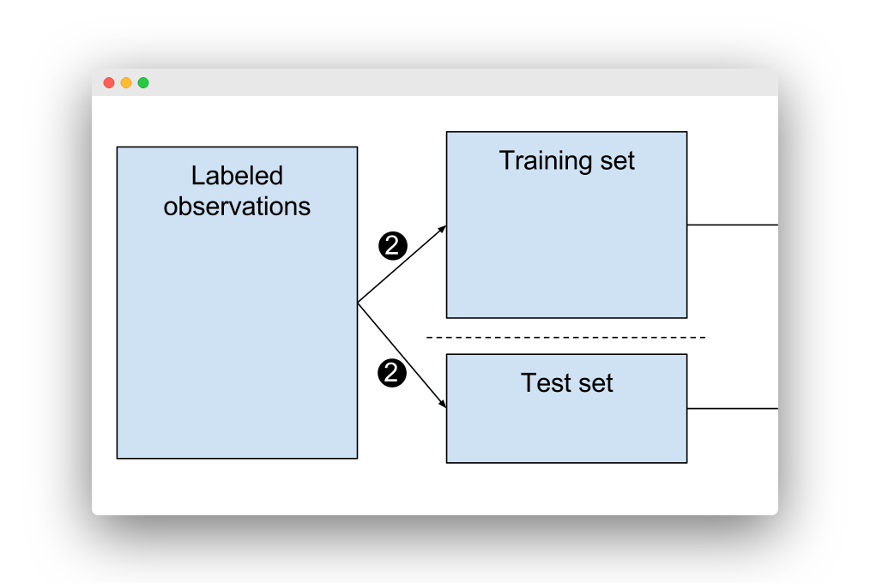
Feature Scaling
Feature scaling is a method used to normalize the range of independent variables or features of data. In data processing, it is also known as data normalization.
Standard scalar standardizes features of the data set by scaling to unit variance. Standardization improves the convergence rate during the optimization process.
Splitting of dataset- Train and Test split
The train-test-split function is for splitting a single dataset for two different purposes: training and testing.
The training subset is for building your model.
The testing subset is for using the model on unknown data to evaluate the performance of the model

Slide 26
MODEL SELECTION AND IMPLEMENTATION
Logistic Regression
Regression is a method to determine a statistical relationship between dependent variable and one or more independent variables.
Logistic regression is a supervised learning classification algorithm used to predict the probability of a target variable. The nature of target or dependent variable is dichotomous, which means there would be only two possible classes.

Slide 27

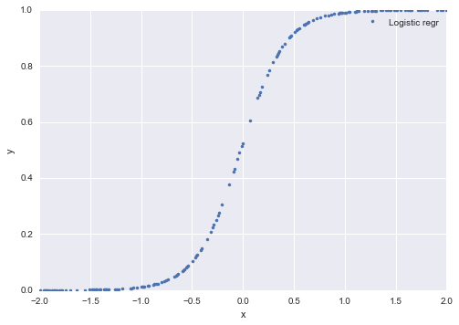
WHY LOGISTIC REGRESSION?
Logistic regression is the appropriate regression analysis to conduct when the dependent variable is dichotomous (binary).
Basic formula of Logistic regression model :-

Slide 28
DECISION TREE MODEL
Decision Tree Learning are a collection of divide and conquer problem-solving strategies that use tree-like structure to predict the value of an outcome variable.
The tree starts with a root node consisting of complete data and thereafter uses intelligent strategies to split the nodes into multiple branches.
This is done to create more homogeneous groups at the children nodes.

Slide 29
Gini index and Entropy are the criterion of decision tree model for calculating information gain.
Both are measures of impurity of a node.
HYPERPARAMETER TUNING:
A hyperparameter is a characteristic of a model that is external to the model and whose value cannot be estimated from data.
GRIDSEARCHCV:
Grid-search is process of scanning and is used to find the optimal hyperparameters of a model which results in the most ‘accurate’ predictions.

Slide 30
COMPARISION AND RESULT
Logistic Regression
Decision Tree Model
Used default parameters
Accuracy score:- 87.15
Used parameter
criterion: - gini
max-depth :- 4
Accuracy score:- 87.22
After applying hyperparameter tuning
criterion: entropy
max-depth: 7
Accuracy score: 87.13

Slide 31
CONCLUSION
Logistic regression and Decision tree classifier are two most popular and basic classification algorithm being used.
But none of the algorithm is better than the other and one’s performance is often credited to the nature of the dataset being work upon
Thus, we the help of this model , we will be able to predict the users who are not willing to enrolled for premium subscription.
We can increase efficiency by providing them with good offers.

Slide 32
THANK YOU

